Slide 1
Electric Forces and
Electric Fields
Physics
Unit 8
Notes:
Physics Unit 8

Slide 2
This Slideshow was developed to accompany the textbook
  OpenStax Physics
    Available for free at https://openstaxcollege.org/textbooks/college-physics
  By OpenStax College and Rice University
  2013 edition
Some examples and diagrams are taken from the textbook.
Slides created by
Richard Wright, Andrews Academy
rwright@andrews.edu

Slide 3
08-01 Static Electric Charge and Conductors
In this lesson you will…
• Define electric charge, and describe how the two types of charge interact.
• State the law of conservation of charge.
• Define conductor and insulator, explain the difference, and give examples of each.
• Describe three methods for charging an object.
• Explain what happens to an electric force as you move farther from the source.

Slide 4

08-01 Static Electric Charge and Conductors
An atom
  Nucleus
    Protons – positive charge
    Neutrons – no charge, but same mass as proton
  Electron cloud
    Electron – negative charge, little mass
    $q_{e}=−1.60×{10}^{−19} C$
      Unit of charge: Coulomb (C)
      $q_{e}$ is the smallest charge discovered
      Electricity is quantized → comes in discreet numbers
      $|q_{e}|$ is the fundamental unit of charge
  In nature atoms have no net charge
    # protons = # electrons

Slide 5
Lab 08-01
Determine what types of materials can create and hold static electricity.

Slide 6

08-01 Static Electric Charge and Conductors
How many electrons does it take to make a charge of
$−4×{10}^{−6} C$? What is their mass (m_{e} = $9.11×{10}^{−31} kg$)?
N = $2.5×{10}^{13}$electrons (a lot)
m = $2.28×{10}^{−17}$kg (very small)
Notes:
$$N=\frac{q}{e} → N=\frac{4×{10}^{−6} C}{1.6×{10}^{−19} C}=2.5×{10}^{13}$$
$$m=2.5×{10}^{13} \left(9.11×{10}^{−31} kg\right)=2.28×{10}^{−17} kg$$

Slide 7
08-01 Static Electric Charge and Conductors
Law of Conservation of Charge
  During any process, the net electrical charge of a closed system remains constant
Like charges repel
Unlike charges attract
  The attraction and repulsion are forces and can be used with Newton’s Laws and other dynamics problems
Notes:
When you rub a balloon on your hair, the balloon steals electrons from the hair. The balloon gets a negative charge and the hair gets a positive charge.
When the balloon takes electrons from the hair, each hair is positively charged. It stands on end because the like positive charges repel
The balloon with the extra electrons sticks to other objects because it has a charge and the other objects don’t. The unlike charges attract

Slide 8
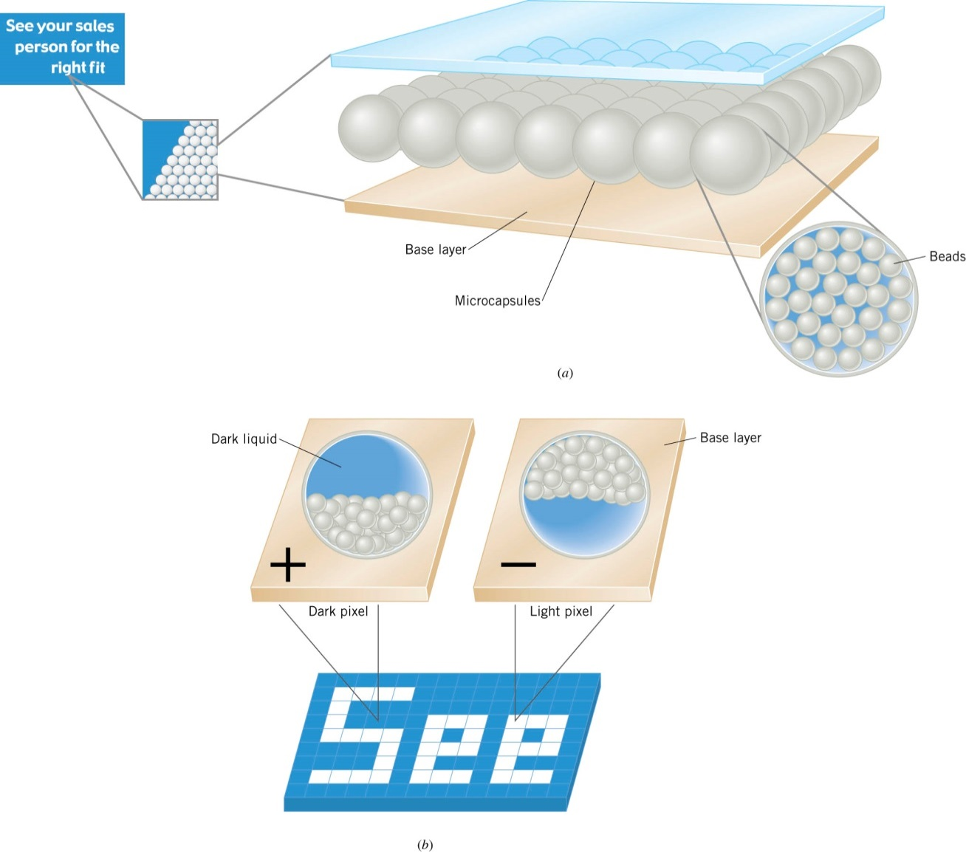
08-01 Static Electric Charge and Conductors
Electric Ink
Notes:
This is different than LCD (in LCD the material is naturally transparent, the charge makes it become opaque)
New Technology
Made of two layers (base and transparent top)
Microcapsules diameter of hair contain white charged beads and dark liquid.
The base layer is electrically charged (some pixels (picture element) are dark because the beads are attracted to the base layer and some are white because the beads are repelled by the base layer)

Slide 9
08-01 Static Electric Charge and Conductors
Electricity can flow through objects
Conductors let electrons flow easily
  Most heat conductors are also electrical conductors
  Metals
Insulators are very poor conductors
  Rubber
  Plastic
  Wood
Notes:
Metals make good conductors because of metallic bonds (chemistry) where the electrons are not strongly attached to the individual nuclei. This happens partly because the outer most layer of electrons is so far away from the nucleus, there isn’t much attraction.
Insulators are made of atoms that hold tightly to their electrons i.e. their electron shells are full or almost full.
Hence electrical wires are coated in plastic

Slide 10
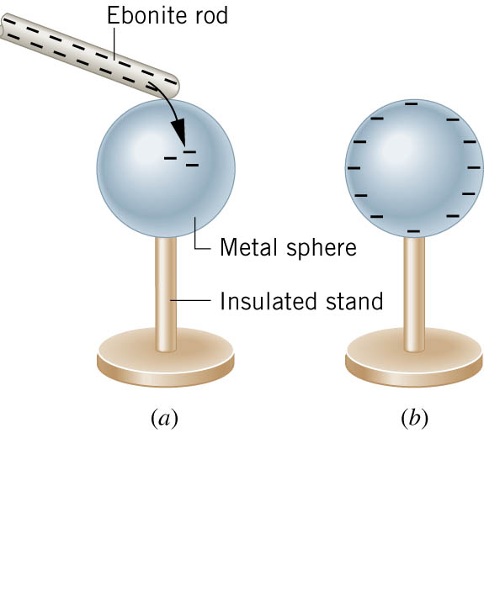
08-01 Static Electric Charge and Conductors
Charging by contact
Negative charged rod gives some electrons to sphere
Sphere becomes negatively charged until charges are equal

Slide 11
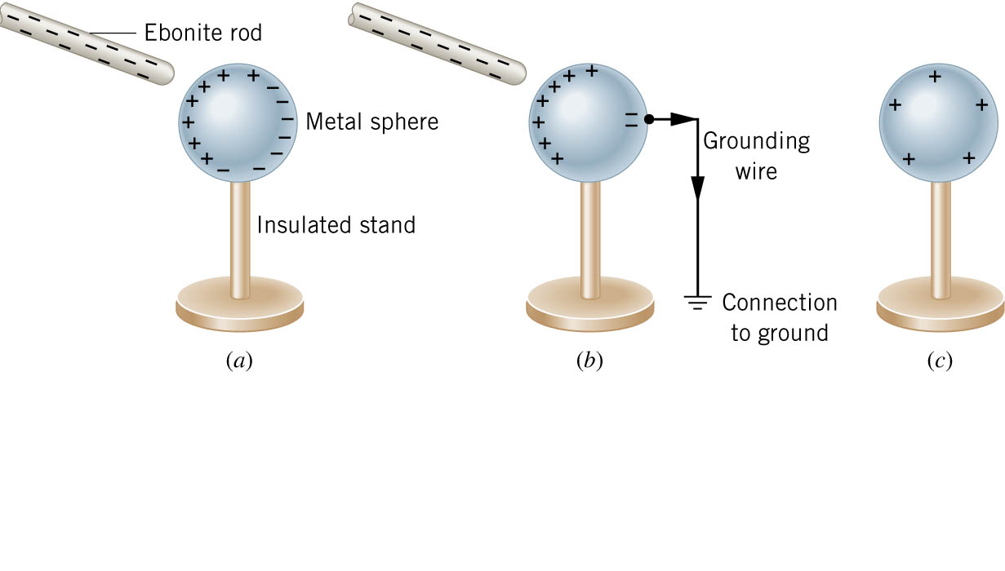
08-01 Static Electric Charge and Conductors
Charge by Induction
Charge without touching
Charged rod comes near neutral sphere
The like charges are repelled to other side of sphere
A grounding wire lets the charges escape from the sphere
The grounding wire is removed, then the charged rod
Sphere is charged
Notes:
Negative rod brought close to the sphere
Negative charge on rod repels electrons on sphere
Electrons move to other side
Electrons are bled off with a ground wire
Wire and rod removed

Slide 12
08-01 Static Electric Charge and Conductors
If the sphere in the previous 2 slides was plastic instead of metal
Electrons wouldn’t flow
The surface would become slightly charged as the electrons in each individual atom rearrange, but no overall effect
Static cling is made by this effect
Notes:
The electrons on one atom shift, this makes the electrons in the neighboring atom shift so that the closest parts have opposite charges and they attract

Slide 13
08-01 Homework
Try charging your way through these problems
Read 18.3

Slide 14
08-02 Coulomb’s Law
In this lesson you will…
• State Coulomb’s law in terms of how the electrostatic force changes with the distance between two objects.
• Calculate the electrostatic force between two charged point forces, such as electrons or protons.
• Compare the electrostatic force to the gravitational attraction for a proton and an electron.

Slide 15
08-02 Coulomb’s Law
Point charges exert force on each other
  Related to the size of the charges and the distance between them
  If the signs are same force repels
  If the signs are opposite force attracts
  Force of the first to the second is equal and opposite of the second to the first
    Newton’s Third Law

Slide 16
08-02 Lab
Do the lab to observe properties of electric force

Slide 17

08-02 Coulomb’s Law
Coulomb’s Law
$$F=k\frac{\left|q_{1}q_{2}\right|}{r^{2}}$$
Where
  F = electrostatic force
  k = constant ($8.99×{10}^{9}$Nm²/C²)
  q = charge
  r = distance between the charges

Slide 18
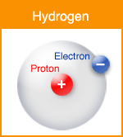

08-02 Coulomb’s Law
In a hydrogen atom, the electron ($q=−1.60×{10}^{−19}$ C) is $5.29×{10}^{−11}$ m away from the proton of equal charge magnitude. Find the electrical force of attraction.
$F=8.22×{10}^{−8}$ N
Notes:
$$F=\frac{\left(8.99×{10}^{9}\frac{Nm^{2}}{C^{2}}\right)\left(\left(1.6×{10}^{−19} C\right)\left(1.6×{10}^{−19} C\right)\right)}{{\left(5.29×{10}^{−11} m\right)}^{2}}=8.22×{10}^{−8} N$$

Slide 19
08-02 Coulomb’s Law
Coulomb’s Law – other notes
  Notice the similarity to Newton’s Law of Universal Gravitation
  Notice that F ∝ 1/r²
    Distance increases by 4, force decreases by 16

Slide 20
08-02 Coulomb’s Law
Force on 1 charge by 2 others
  Work in two parts
    Find force of attraction by one of the points
    Find force of attraction by the other point
    Add the force vectors
      REMEMBER!!!!! → you have to add the x and y components!!!!!

Slide 21
08-02 Coulomb’s Law
There are three charges in a straight line
q₁ = +2μC at x = -0.1 m
q₂ = -3 μC at x = 0 m
q₃ = +5 μC at x = 0.3 m
What is the force on q₂?
F = -3.89 N
Notes:
$F_{12}=8.99×{10}^{9}\frac{Nm^{2}}{C^{2}}\frac{\left(2×{10}^{−6} C\right)\left(3×{10}^{−6} C\right)}{{\left(0.1 m\right)}^{2}} = −5.39 N$(neg because pulling in – direction)
$F_{23}=8.99×{10}^{9}\frac{Nm^{2}}{C^{2}}\frac{\left(5×{10}^{−6} C\right)\left(3×{10}^{−6} C\right)}{{\left(0.3 m\right)}^{2}} = 1.50 N$ (pos because pulling in + direction)
$F=F_{12}+F_{23}=−5.39 N+1.50 N=−3.89 N$

Slide 22
08-02 Coulomb’s Law
There are three charges
q₁ = +2μC at (0, 0.3) m
q₂ = -3 μC at (0, 0) m
q₃ = +5 μC at (0.1, 0.2) m
What is the force on q₂?
F = 3.247 N @ 68.1° above horizontal
Notes:
$$F_{12}=8.99×{10}^{9}\frac{Nm^{2}}{C^{2}}\frac{\left(2×{10}^{−6} C\right)\left(3×{10}^{−6} C\right)}{{\left(0.3 m\right)}^{2}} = .599 N$$
$$r=\sqrt{{0.1}^{2} + {0.2}^{2}} = .2236 m$$
$$=\cos^{−1} \left(\frac{.1}{.2236}\right) = 63.4 deg$$
$$F_{23}=8.99×{10}^{9}\frac{Nm^{2}}{C^{2}}\frac{\left(5×{10}^{−6} C\right)\left(3×{10}^{−6} C\right)}{{\left(0.2236 m\right)}^{2}} = 2.70 N$$
$$x−components: F_{12}=0 N, F_{23}=2.70\cos{63.4°}=1.209 N$$
$$ADD:0 N+1.209 N=1.209 N$$
$$y−component: F_{12}=0.599 N, F_{23}=2.70\sin{63.4°}=2.414 N$$
$$ADD:0.599 N + 2.414 N = 3.013 N$$
$$r=\sqrt{1.2092 + 3.0132}=3.247 N$$
$$θ=\cos^{−1}{\frac{1.209}{3.247}}=68.1°$$

Slide 23
08-02 Homework
Charge these problems to your grade
Read 18.4, 18.5

Slide 24
08-03 Electric Field and Electric Field Lines
In this lesson you will…
• Describe a force field and calculate the strength of an electric field due to a point charge.
• Calculate the force exerted on a test charge by an electric field.
• Explain the relationship between electrical force (F) on a test charge and electrical field strength (E).
• Calculate the total force (magnitude and direction) exerted on a test charge from more than one charge
• Describe an electric field diagram of a positive point charge; of a negative point charge with twice the magnitude of
positive charge
• Draw the electric field lines between two points of the same charge; between two points of opposite charge.

Slide 25
08-03 Electric Field and Electric Field Lines
We can use a test charge to determine how the surrounding charges generate a force
Pick a small test charge so it doesn’t change the surrounding charge orientation

Slide 26

08-03 Electric Field and Electric Field Lines
A test charge ($q_{0}=1.0×{10}^{−10} C$) experiences a force of $2×{10}^{−9} N$ when placed near a charged sphere. Determine the Force per Coulomb that the charge experiences and predict the force on a $2 C$ charge.
$\frac{F}{q_{0}}=20 N/C$
$F=40 N$
Notes:
$$\frac{F}{q_{0}}=\frac{2×{10}^{−9} N}{1×{10}^{−10} C}=20\frac{N}{C}$$
$$F=20\frac{N}{C} (2 C)=40 N$$

Slide 27

08-03 Electric Field and Electric Field Lines
Electric Field Definition
$$E=\frac{F}{q_{0}}=\frac{kq_{1}}{r^{2}}$$
  Force per charge
  Vector
    Same direction as the force on a positive test charge
    Remember to add them as vectors!!!!
  Unit: N/C
Notes:
The surrounding charges create the electric field at a given point
As we will see, the test charge does not affect the electric field

Slide 28
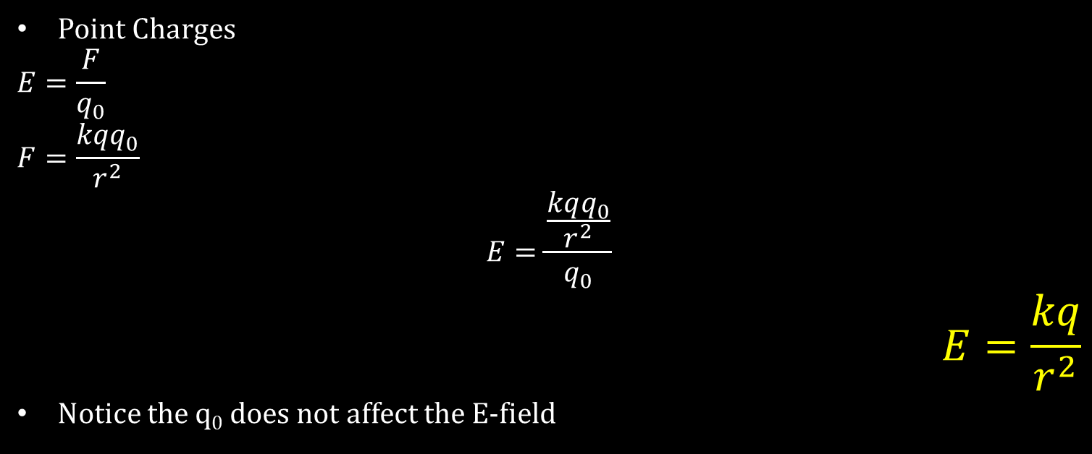
08-03 Electric Field and Electric Field Lines
Point Charges
$$E=\frac{F}{q_{0}}$$
$$F=\frac{kqq_{0}}{r^{2}}$$
$$E=\frac{\frac{kqq_{0}}{r^{2}}}{q_{0}}$$
$$E=\frac{kq}{r^{2}}$$
Notice the q₀ does not affect the E-field

Slide 29

08-03 Electric Field and Electric Field Lines
There is a point charge of $q=2×{10}^{−8} C$. Determine the E-field at 0.50 m away using a test charge of $1×{10}^{−10} C$.
E = 719 N/C
Notes:
$$E=\frac{kq}{r^{2}}$$
$$E=\frac{\left(8.99×{10}^{9}\frac{Nm^{2}}{C^{2}}\right)\left(2×{10}^{−8} C\right)}{{\left(0.50 m\right)}^{2}}=719.2 N/C$$

Slide 30
08-03 Electric Field and Electric Field Lines
There are two point charges of q₁ = 4 C and q₂ = 8 C and they are 10 m apart. Find point where E = 0 between them.
d = 5.85 m from q₂ towards q₁
Notes:
Pick the distance from the first as d and the distance from the second as 10 – d
Set E-fields equal to each other
$$\frac{k8 C}{d^{2}}=\frac{k4 C}{{\left(10−d\right)}^{2}}$$
$$\frac{8}{d^{2}}=\frac{4}{{\left(10−d\right)}^{2}}$$
$$8{\left(10−d\right)}^{2}=4d^{2}$$
$$2\sqrt{2}\left(10−d\right)=±2d$$
$$28.2−2.82d=±2d$$
$$Take +: 28.2−2.82d=2d → 28.2=4.82d → d=5.85$$
$$Take −: 28.2−2.82d=−2d → 28.2=0.82 d → d=34.39$$
Answer is 5.85

Slide 31
08-03 Electric Field and Electric Field Lines
It would be nice to have some kind of map to show the E-field in space
Rules
  Lines begin at positive charges only
  Lines end at negative charges only
  The number of lines entering or leaving a charge is proportional to the size of charge
  Lines don’t cross each other
  Lines leave surfaces at 90 degrees
Notes:
Spread out lines → weak E-field
Close lines → strong E-field
Lines don’t cross because there is only one value of E at one point

Slide 32
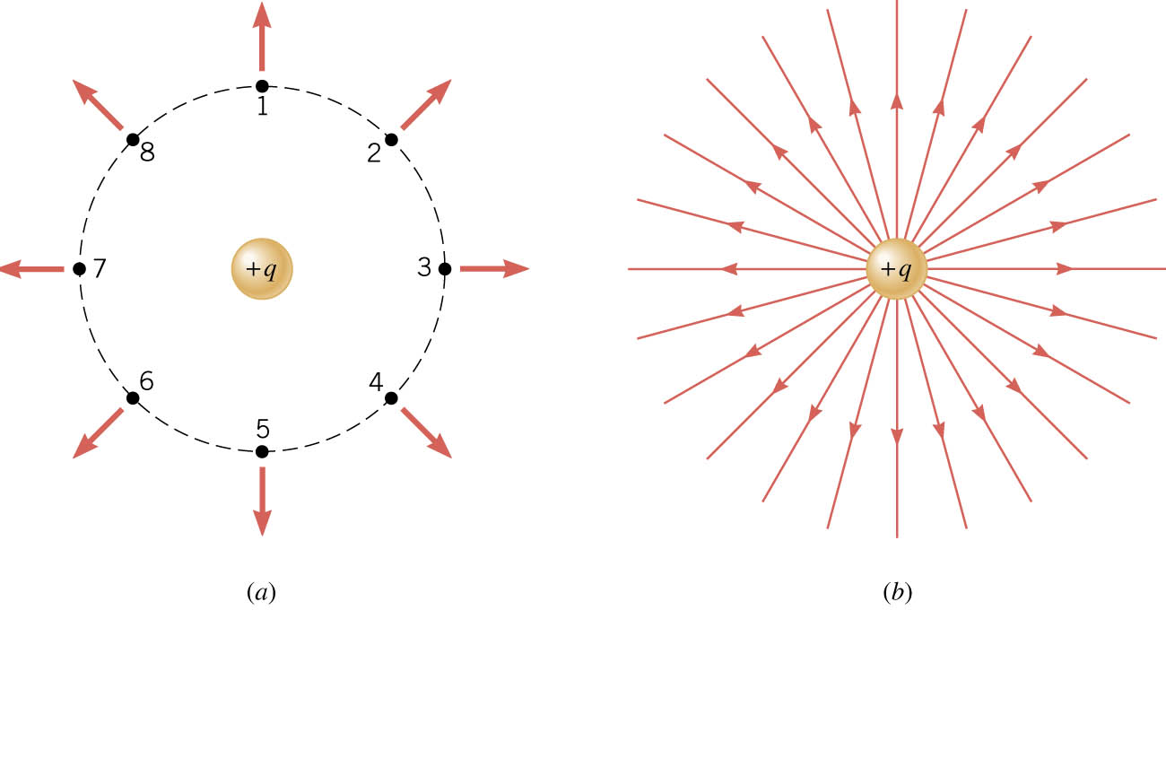
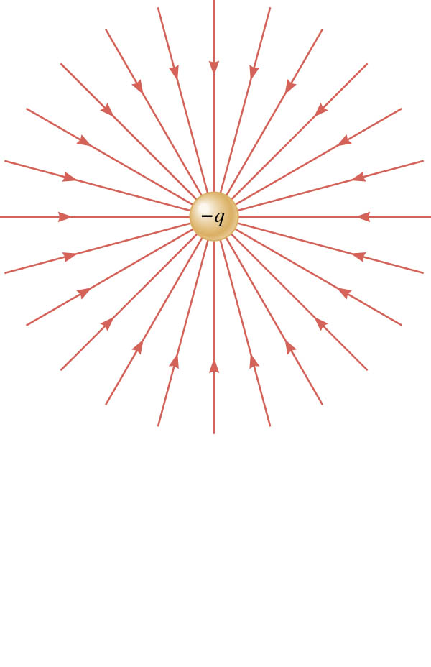
08-03 Electric Field and Electric Field Lines
Notes:
Made by putting test charge in points and seeing direction and strength of E-field

Slide 33
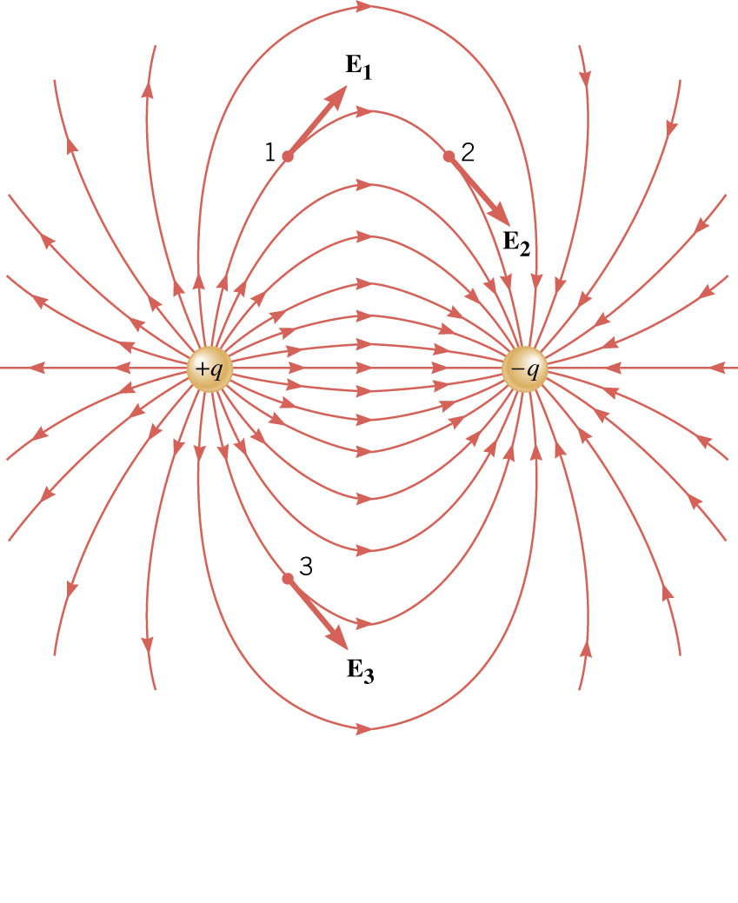
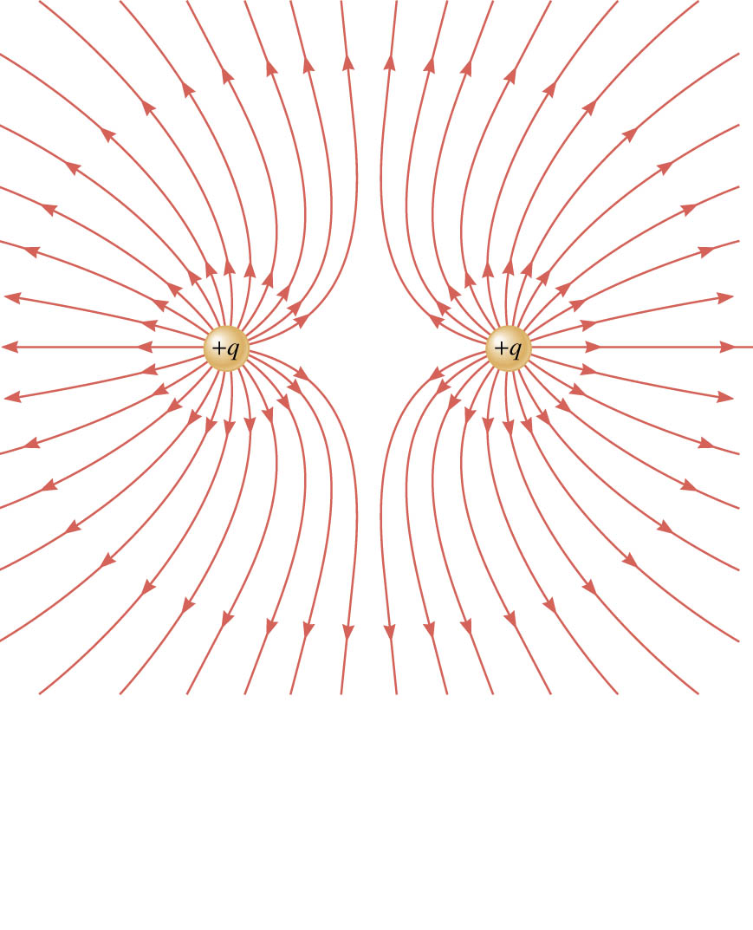
08-03 Electric Field and Electric Field Lines

Slide 34
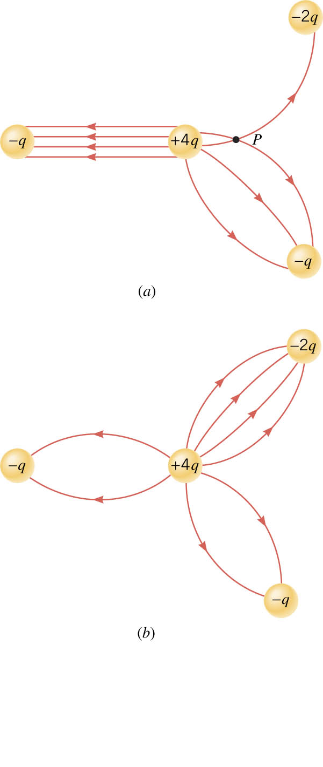
08-03 Electric Field and Electric Field Lines
What is wrong here?
Notes:
Lines on left should be curved→ as is the charge would constant between them, should depend on distance
Lines cross at point P
Number of lines should be proportional to charge 1:4:2:1 or 2:8:4:2 to make symmetry

Slide 35
08-03 Lab
Create your own electric field map

Slide 36
08-03 Homework
Electrify your brain and answer these problems
Read 18.6, 18.7, 18.8

Slide 37
08-04 Conductors in Equilibrium and Applications
In this lesson you will…
• List the three properties of a conductor in electrostatic equilibrium.
• Explain the effect of an electric field on free charges in a conductor.
• Explain why no electric field may exist inside a conductor.
• Explain what happens to an electric field applied to an irregular conductor.
• Describe how a lightning rod works.
• Explain how a metal car may protect passengers inside from the dangerous electric fields caused by a downed line touching the car.
• Name several real-world applications of the study of electrostatics.

Slide 38
08-04 Lab
Discover something weird about phones in boxes and bags

Slide 39

08-04 Conductors in Equilibrium and Applications
Conductors contain free charges that move easily
When extra charges are present, they quickly move to places where the electric field is $⊥$ to the surface
Then they stop moving
This is electrostatic equilibrium
Notes:
If there was a parallel component to the electric field, then they charges would move along the surface

Slide 40
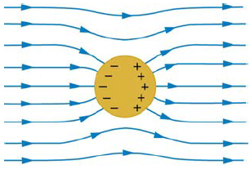

08-04 Conductors in Equilibrium and Applications
Conductor in electric field will polarize
Inside conductor, E-field = 0
Just outside of conductor, E-field is $⊥$ to surface
Any excess charge resides on surface
  They get as far apart as possible

Slide 41
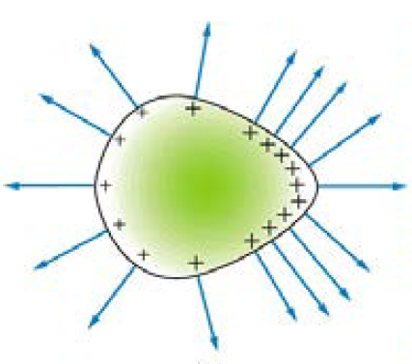
08-04 Conductors in Equilibrium and Applications
If the surface is uneven, more charge will collect near the area of most curvature
If the curve is great enough, the E-field can be strong enough to remove excess charge
  Lightning Rods

Slide 42
08-04 Conductors in Equilibrium and Applications
Shielding
  A conductor shields any charge within it from external electrical fields
  Sensitive electrical equipment is shielded by putting in a metal box
    Called Faraday Cage
  Coaxial cable is shielded by a metal cylinder around the central metal wire. This reduces interference and signal loss

Slide 43
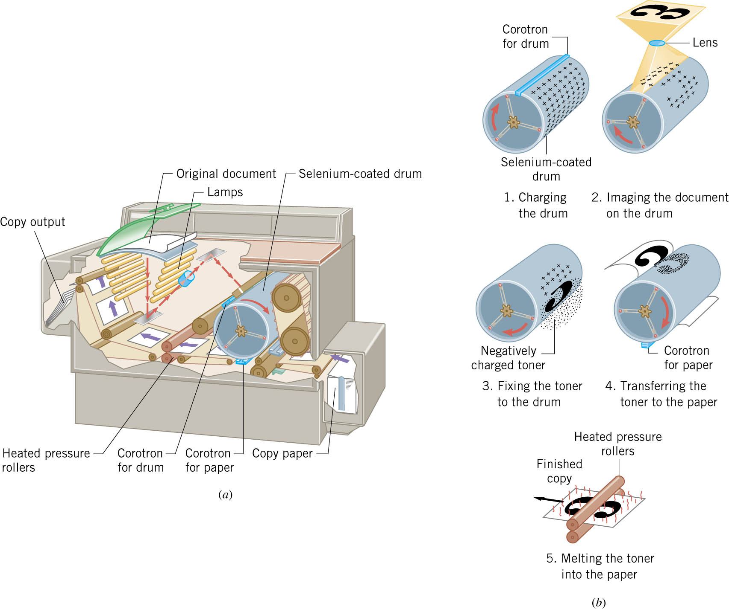
08-04 Conductors in Equilibrium and Applications
Copier
Notes:
Xerography (means dry writing in Greek)
Xerographic drum is aluminum coated with selenium
Selenium is a photoconductor
Photoconductor is a conductor in light, but insulator in dark
The drum is given a positive charge
Lenses and mirrors shine the image onto the drum
Where light hits the drum, selenium is conductor and becomes neutralized, where image is is dark so stays insulator and positive charge
Toner given negative charge so it sticks to positive areas of drum
Paper is give big positive charge so toner covering only the image sticks to the paper
Paper is heated to melt in the toner

Slide 44
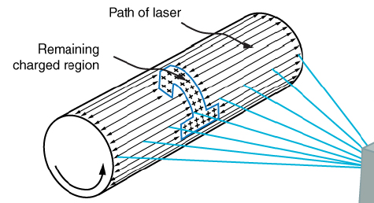
08-04 Conductors in Equilibrium and Applications
Laser Printer
  Similar to copier machine only the image is put on the drum using a laser
  The laser scans the drum quickly
  The computer turns the laser on and off at the right time to produce the image

Slide 45
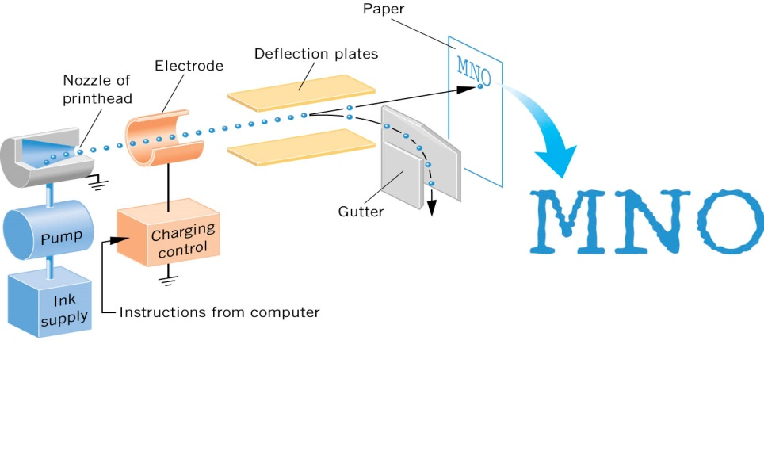
08-04 Conductors in Equilibrium and Applications
Inkjet printer
Notes:
One type only!!!
As print head shuttles back and forth across paper, ink is finely sprayed (extremely small drops)
Where no ink wanted
Electrode gives the drops an electrical charge by induction
Deflection plates use the electrical charge to divert the ink into a gutter
When want ink on paper
The Electrode is turned off, so no charge on ink
Ink goes straight to paper.

Slide 46
08-04 Homework
Try going beyond the surface of these problems
Read 19.1

Slide 47
08-05 Electric Potential Energy: Potential Difference
In this lesson you will…
• Define electric potential and electric potential energy.
• Describe the relationship between potential difference and electrical potential energy.
• Explain electron volt and its usage in submicroscopic process.
• Determine electric potential energy given potential difference and amount of charge.

Slide 48

08-05 Electric Potential Energy: Potential Difference
Change in PE due to Gravity
  Force of gravity is conservative
  W = mgh₀ – mgh_{f} = PE₀ – PE_{f}
Change in PE due to Electrical Force
  Electrical Force is conservative
  W = PE₀ - PE_{f}
$$F_{G}=G\frac{m_{1}m_{2}}{r^{2}}$$
$$F_{E}=k\frac{q_{1}q_{2}}{r^{2}}$$

Slide 49

08-05 Electric Potential Energy: Potential Difference
Since $E=\frac{F}{q_{0}}$ it is useful to have $\frac{W}{q_{0}}=\frac{EPE}{q_{0}}$
Electric Potential (or Potential)
  $V=\frac{EPE}{q_{0}}$
  Unit: volt (V = J/C)
Notes:
Point out that the Electric Potential and the Electrical Potential Energy are different
EPE → energy measured in joules
V → energy per unit charge measured in V

Slide 50

08-05 Electric Potential Energy: Potential Difference
Electric Potential Difference
$$V_{f}−V_{0}=\frac{PE_{f}}{q_{0}}−\frac{PE_{0}}{q_{0}}=−\frac{W}{q_{0}}$$
$$ΔV=\frac{ΔPE}{q_{0}}=−\frac{W}{q_{0}}$$
V and EPE can only be measured in differences

Slide 51

08-05 Electric Potential Energy: Potential Difference
Electric force moves a charge of $2×{10}^{−10}$C from point A to point B and does $5×{10}^{−6}$ J of work.
What is the difference in potential energies of A and B (PE_{A} – PE_{B})?
  PE_{A} – PE_{B} = $5×{10}^{−6}$J
What is the potential difference between A and B (V_{A} – V_{B})?
  V = 25000 V Point A is higher potential
Notes:
$$EPE: W_{AB}=−W_{BA}=EPE_{A}−EPE_{B}=5×{10}^{−6} J$$
$$V: V_{A}−V_{B}=−\frac{W_{BA}}{q_{0}}=\frac{5×{10}^{−6} J}{2×{10}^{−10} C}=25000 V$$

Slide 52
08-05 Electric Potential Energy: Potential Difference
Electric Potential Difference and Charge Sign
  Positive Charge
    Moves from higher electrical potential toward lower electrical potential
  Negative Charge
    Moves from lower to higher electrical potentials

Slide 53
08-05 Electric Potential Energy: Potential Difference
Points A, B, and C are evenly spaced on a line. A positive test charge is released from A and accelerates towards B, from B it decelerates, but doesn’t stop at C. What happens when a negative charge is released at B?
Accelerates towards A
Notes:
B has the lowest potential. (positive accelerate to it and slows after passing)
C has next lowest potential. (while the distance was the same, the charge didn’t stop)
A has the highest potential.
Negative charge will accelerate towards the highest potential

Slide 54
08-05 Electric Potential Energy: Potential Difference
Batteries
  Even though it is the negative electrons that actually move, tradition says that we talk about moving positive charges
  Positive charge repelled by positive terminal
  Moves through light bulb and energy converted to heat
  By the time the positive charge reaches the negative terminal, it has no potential energy left

Slide 55

08-05 Electric Potential Energy: Potential Difference
Volts and Energy
  $V=\frac{EPE}{q_{0}}$
  $EPE=q_{0}V$
  Use this when solving conservation of energy problems
  Unit for small energy is electron volts (eV)
    $eV=\left(1.60×{10}^{−19} C\right)\left(1 V\right)=1.6×{10}^{−19} J$
Notes:
If you are looking for the change in electrical potential energy multiply the potential difference by the charge
Conservation of energy is where the initial E = final E of all types including GPE, EPE, KE, etc

Slide 56
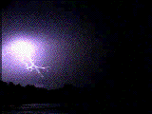

08-05 Electric Potential Energy: Potential Difference
When lightning strikes, the potential difference can be ten million volts between the cloud and ground. If an electron is at rest and then is accelerated from the ground to the cloud, how fast will it be moving when it hits the cloud 0.5 km away (ignore relativity effects)?
$v=1.87×{10}^{9} m/s$
Notes:
$$\text{Conservation} \text{of} \text{Energy}$$
$$E=KE+GPE+EPE$$
$$Final=initial$$
$$KE_{f}+\left(9.11×{10}^{−31} kg\right)\left(9.8\frac{m}{s^{2}}\right)\left(500m\right)+\left(1×{10}^{7} V\right)\left(−1.6×{10}^{−19} C\right)=0+0+0$$
$$KE_{f}+4.46×{10}^{−27} J−1.6×{10}^{−12} J=0$$
$$KE_{f}−1.6×{10}^{−12} J=0 → KE_{f}=1.6×{10}^{−12} J$$
$$KE=\frac{1}{2}mv^{2} → 1.6×{10}^{−12} J=\frac{1}{2}\left(9.11×{10}^{−31} kg\right)v^{2} → 3.51×{10}^{18}=v^{2} → v=1.87×{10}^{9}\frac{m}{s}$$
$$Faster than speed of light so must use relativity which we will study later$$

Slide 57
08-05 Homework
Try these potential puzzling problems
Read 19.2

Slide 58
08-06 Electric Potential in a Uniform Electric Field
In this lesson you will…
• Describe the relationship between voltage and electric field.
• Derive an expression for the electric potential and electric field.
• Calculate electric field strength given distance and voltage.

Slide 59
08-06 Electric Potential in a Uniform Electric Field
Both electric field and electric potential can be used to describe charges
E
  deals with force
  vector
V
  deals with energy
  scalar

Slide 60

08-06 Electric Potential in a Uniform Electric Field
Uniform Electric Field
$W=−ΔPE=−qΔV$
$−ΔV=−\left(V_{B}−V_{A}\right)=\left(V_{A}−V_{B}\right)=V_{AB}$
$W=qV_{AB}$
$W=Fd$
$Fd=qV_{AB}$
$F=qE$
$qEd=qV_{AB}$
$V_{AB}=Ed$ or $E=\frac{V_{AB}}{d}$

Slide 61
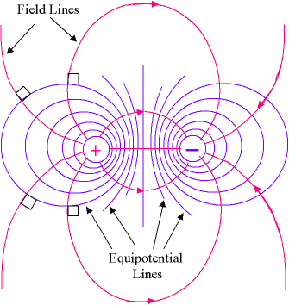

08-06 Electric Potential in a Uniform Electric Field
In general
$$E=−\frac{ΔV}{Δs}$$
E is gradient (slope) of V vs. s (displacement)
On picture, E-field lines show force. V lines are where V are same
The closer V lines are, the stronger E is.

Slide 62
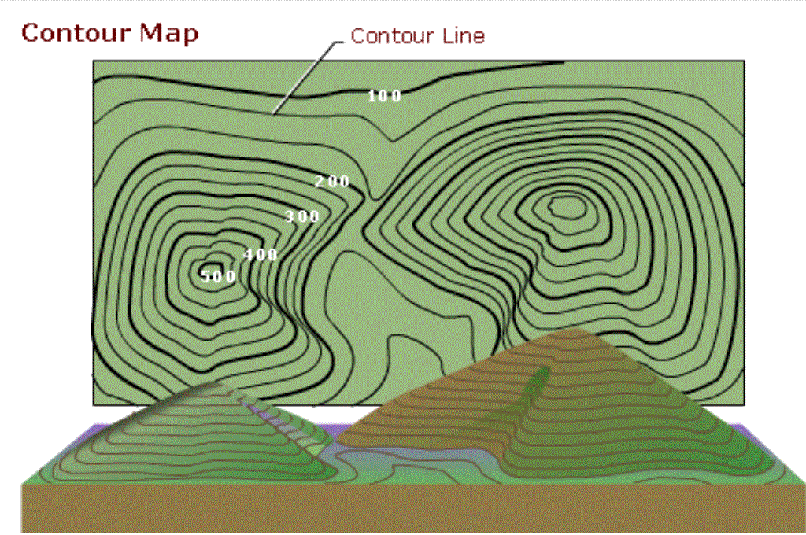
08-06 Electric Potential in a Uniform Electric Field
Notes:
Field lines and equipotential lines like topographic map where altitudes are equipotential lines and slopes are like field lines

Slide 63

08-06 Electric Potential in a Uniform Electric Field
How far apart are two conducting plates that have an electric field strength of $4.50×{10}^{3}$ V/m between them, if their potential difference is 15.0 kV?
D = 3.33 m
Notes:
$$E=\frac{V_{AB}}{d}$$
$$4.50×{10}^{3}\frac{V}{m}=\frac{15000 V}{d}$$
$$d=\frac{15000 V}{4.50×{10}^{3}\frac{V}{m}}=3.33 m$$

Slide 64

08-06 Electric Potential in a Uniform Electric Field
A doubly charged ion is accelerated to an energy of 15.0 keV by the electric field between two parallel conducting plates separated by 3.00 mm. What is the electric field strength between the plates?
E = $2.5×{10}^{6} N/C$
Notes:
$$15 keV\left(\frac{1000 eV}{1 keV}\right)\left(\frac{1.60×{10}^{−19} J}{1 eV}\right)=2.4×{10}^{−15} J$$
$$E=\frac{V_{AB}}{d}→Ed=V_{AB}$$
$$W=qV_{AB}$$
$$W=qEd$$
$$E=\frac{W}{qd}$$
$$E=\frac{2.4×{10}^{−15} J}{\left(2⋅1.60×{10}^{−19} C\right)\left(0.003 m\right)}=2.5×{10}^{6} N/C$$

Slide 65
08-06 Homework
You have the potential to succeed.
Read 19.3, 19.4

Slide 66
08-07 Electric Potential Due to a Point Charge and Equipotential Lines
In this lesson you will…
• Explain point charges and express the equation for electric potential of a point charge.
• Distinguish between electric potential and electric field.
• Determine the electric potential of a point charge given charge and distance.
• Explain equipotential lines and equipotential surfaces.
• Compare electric field and equipotential lines.

Slide 67
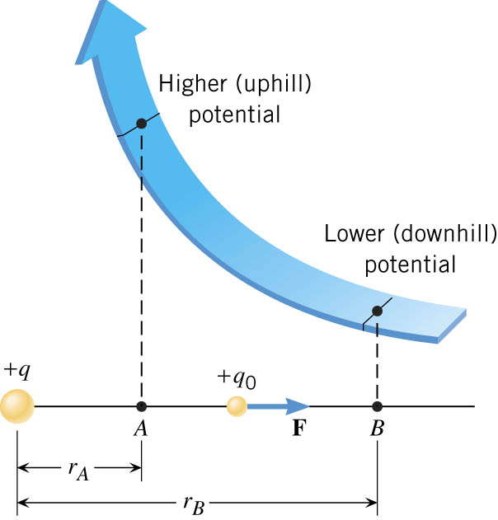
08-07 Electric Potential Due to a Point Charge and Equipotential Lines
Notes:
Charge at q
Two points at distances rA and rB
At both these points a small positive test charge is repelled by the force F = (kqq/r²)
This force does work to move the test charge from A to B
Since r varies from A to B and the force varies also, so must use calculus integrals to find the work done
W_{AB} = kqq₀/rA – kqq₀/rB
The potential difference can be found
V_{B} – V_{A} = -W_{AB}/q₀ = kq/rB – kq/rA
If we make rB very large (infinite) then kq/rB = 0 and V_{B} = 0
For convenience we always set V_{B} = 0 so
V = kq/r

Slide 68

08-07 Electric Potential Due to a Point Charge and Equipotential Lines
Potential of a Point Charge
$$V=\frac{kq}{r}$$
V is NOT the absolute potential
V IS the potential difference if a test charge were moved to a distance of r from infinity

Slide 69
08-07 Electric Potential Due to a Point Charge and Equipotential Lines
Two or more charges
  Find the potentials due to each charge at that location
  Add the potentials together to get the total potential

Slide 70
08-07 Electric Potential Due to a Point Charge and Equipotential Lines
Two charges are 1 m apart. The charges are +2 μC and -4 μC. What is the potential 1/3 of the way between them?
0 V
Notes:
$$V=\frac{kq}{r}$$
$$V=\frac{\left(8.99×{10}^{9}\frac{Nm^{2}}{C^{2}}\right)\left(2×{10}^{−6} C\right)}{0.333333 m}+\frac{\left(8.99×{10}^{9}\frac{Nm^{2}}{C^{2}}\right)\left(−4×{10}^{−6} C\right)}{0.666667 m}=0 V$$

Slide 71

08-07 Electric Potential Due to a Point Charge and Equipotential Lines
How much work is done ($−W=PE_{f}−PE_{0}$) to bring two electrons to a distance of $5.3×{10}^{−11}$ m to the nucleus of a Helium atom ($q=3.2×{10}^{−19} C$)?
$W=1.52×{10}^{−17} J$
Notes:
Start by saying that the potential at infinity is 0.
Find the potential at the orbit due to the nucleus:
$$V=\frac{kq}{r}=\frac{\left(8.99×10^{9}\frac{Nm^{2}}{C^{2}}\right)\left(3.2×10^{−19} C\right)}{5.3×10^{−11} m}=54.3 V$$
Find the work done to bring the first electron in from infinity:
$$EPE=qV=\left(1.6×10^{−19} C\right)\left(54.3 V\right)=8.68×10^{−18} J$$
Find the new potential at the orbit (new electron will want to come into the opposite side of the orbit):
$$V=\frac{kq}{r}+\frac{kq}{r}=\frac{\left(8.99×10^{9}\frac{Nm^{2}}{C^{2}}\right)\left(3.2×10^{−19} C\right)}{5.3×10^{−11} m}+\frac{\left(8.99×10^{9}\frac{Nm^{2}}{C^{2}}\right)\left(−1.6×10^{−19} C\right)}{10.6×10^{−11} m}=40.7 V$$
Find the work to bring in the second electron
$$EPE=qV=\left(1.6×10^{−19} C\right)\left(40.7 V\right)=6.51×10^{−18} J$$
Find the Total
$$EPE_{total}=8.68×10^{−18} J+6.51×10^{−18} J=1.52×10^{−17} J$$

Slide 72
08-07 Lab
Create a map of equipotentials

Slide 73
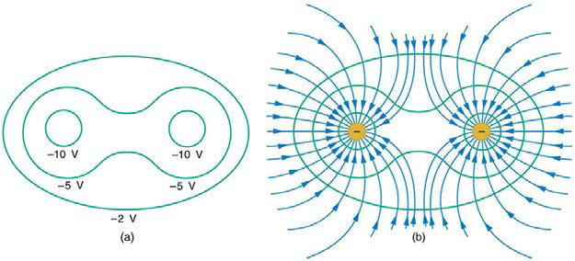

08-07 Electric Potential Due to a Point Charge and Equipotential Lines
Equipotential Lines
  Lines where the electric potential is the same
  Perpendicular to E-field
  No work is required to move charge along equipotential line since $qΔV=0$

Slide 74
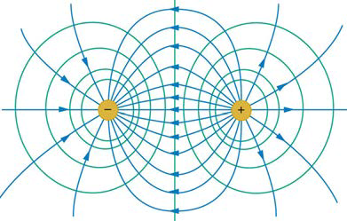
08-07 Electric Potential Due to a Point Charge and Equipotential Lines
Notes:
Field lines and equipotential lines like topographic map where altitudes are equipotential lines and slopes are like field lines

Slide 75
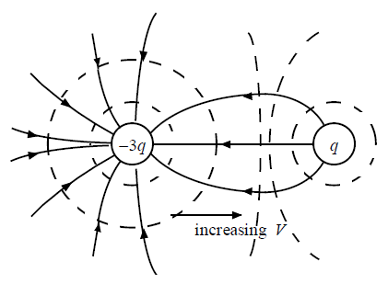
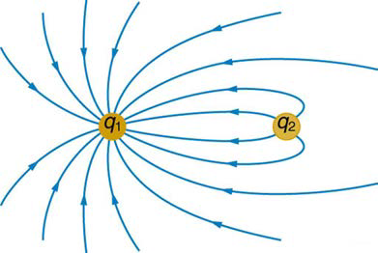
08-07 Electric Potential Due to a Point Charge and Equipotential Lines
Sketch the equipotential lines in the vicinity of two opposite charges, where the negative charge is three times as great in magnitude as the positive.

Slide 76
08-07 Homework
Let me charge you with this point: You can reach your potential.

